Slide 1
Decentralised Digital Identity (DID) and Verifiable Credentials
Rory Braybrook
Microsoft Identity Architect
Microsoft MVP (Enterprise Mobility)
@rbrayb
https://authory.com/RoryBraybrook

Slide 2
Notes
Microsoft perspective
Microsoft is a major player in the open standards forums
Information made public a month ago
Brand spanking shiny new
Seems to have been 10 Meetups worldwide to date
This seems to be the first in APAC – Sydney end May
Everyone's still learning
No existing frame of reference
Currently requires Azure AD P2
Public preview

Slide 3
Decentralised Identity

Slide 4
Forrester
"Decentralized digital identity (DDID) is not just a technology buzzword: It promises a complete restructuring of the currently centralized physical and digital identity ecosystem into a decentralized and democratized architecture."

Slide 5
What is decentralized identity?
Decentralized identity is a trust framework in which identifiers, such as usernames, can be replaced with IDs that are self-owned, independent, and enable data exchange using blockchain and distributed ledger technology to protect privacy and secure transactions.

Slide 6
Why is decentralized identity important?
"As our lives are increasingly linked to apps, devices, and services, we’re often subject to data breaches and privacy loss. A standards-based decentralized identity system can provide greater privacy and control over your data."

Slide 7
More about decentralized identity
"Microsoft believes everyone has the right to own their digital identity, one that more securely and privately stores all personal data. This identity must seamlessly integrate into daily life and give complete control over data access and use."

Slide 8
Open Standards
Decentralized Identity Foundation (DIF)
Sidetree DID network protocol (which underpins ION)
W3C Decentralized Identifiers
W3C DID Method Registry
W3C Verifiable Credentials
DIF Well Known DID Configuration
DIF DID-SIOP
DIF Presentation Exchange

Slide 9
ION
ION (an instantiation of Sidetree on Bitcoin)
ION = Identity Overlay Network
Microservices in Azure AKS
ION is not another blockchain, it's a Layer 2 protocol that directly leverages Bitcoin's security
ION is not a cryptocurrency
Can run your own instance or can use Docker

Slide 10
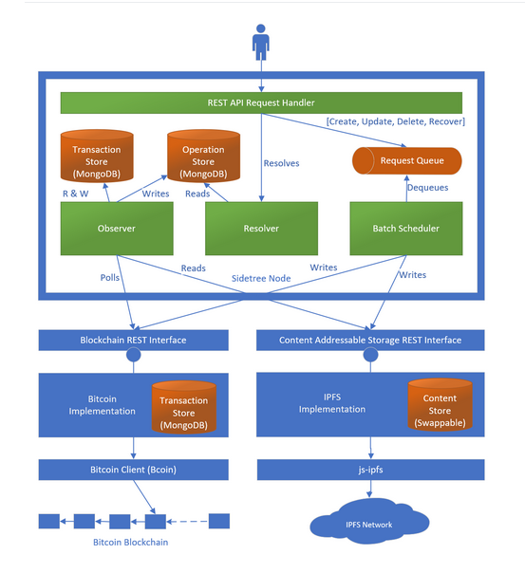
Sidetree

Slide 11
Verifiable Credentials

Slide 12
What are verifiable credentials
Verifiable credentials are data objects consisting of claims made by the issuer attesting information about a subject. These claims are identified by schema and include the DID the issuer and subject. The issuer's DID creates a digital signature as proof that they attest to this information.

Slide 13
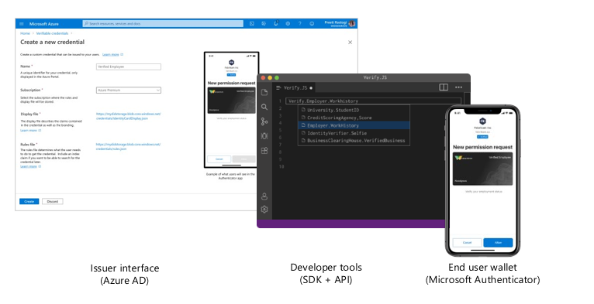
Platform

Slide 14
Scenarios
Fast remote onboarding
Digitally validate any piece of information with ID verification services for quick, trustworthy self-service enrollment and onboarding.
Access to high-value apps
Verify credentials from a wide variety of trusted partners based on open standards as an additional proof of authentication.
Self-service account recovery
Replace support phone calls and security questions with a simpler, more secure process to verify user identity.

Slide 15
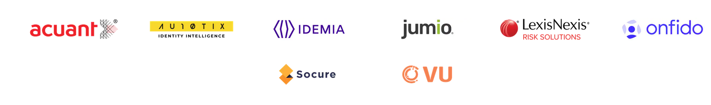
Microsoft partners

Slide 16
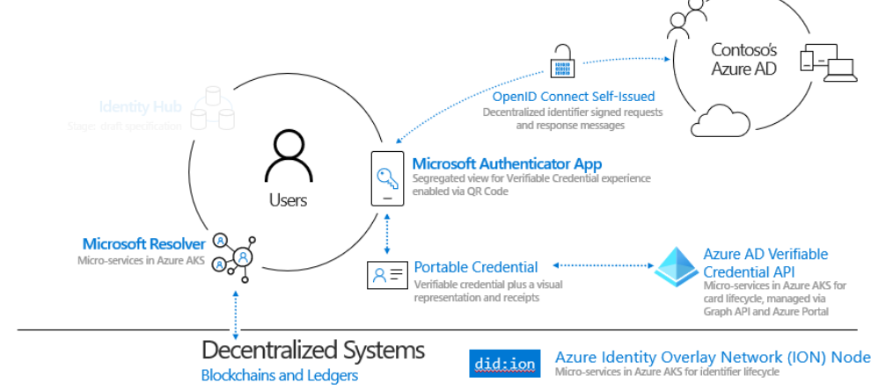
Overview

Slide 17
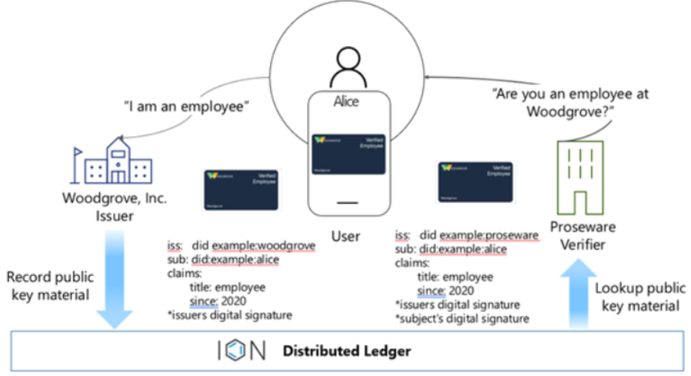
Sample scenario

Slide 18
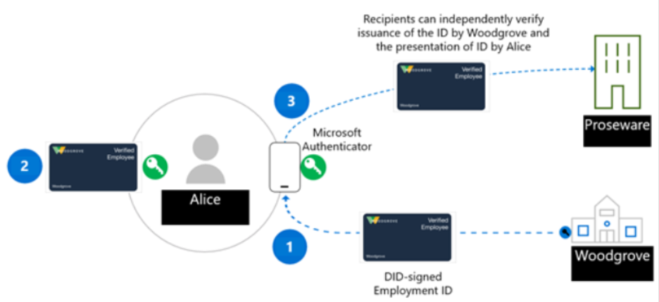
Roles – Issuer, User & Verifier

Slide 19
The Infrastructure

Slide 20
Azure
Need Key Vault to store the keys
Need Blob (Container) storage to store the JSON rules and display files
Need to enable VC (preview)

Slide 21
Files
Public sample
Issuer and verifier folders
Update files in issuer_config folder
Update app.js

Slide 22
Demo
DIF ION Network Explorer

Slide 23
The VC Journey

Slide 24
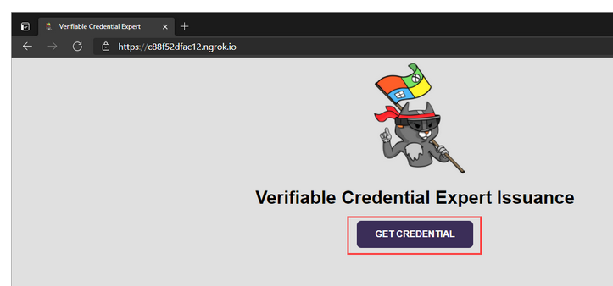
Issue a VC

Slide 25
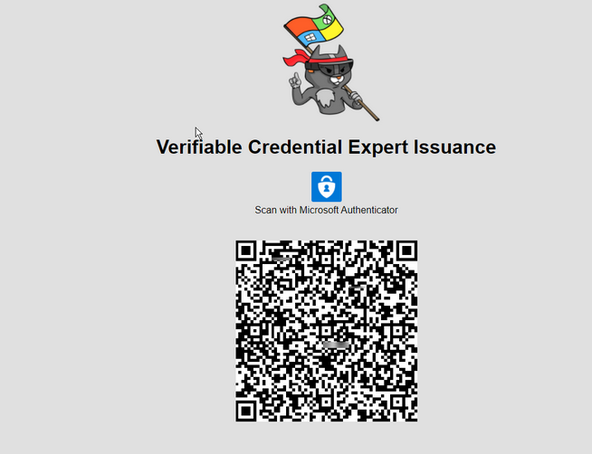
Issue a VC

Slide 26
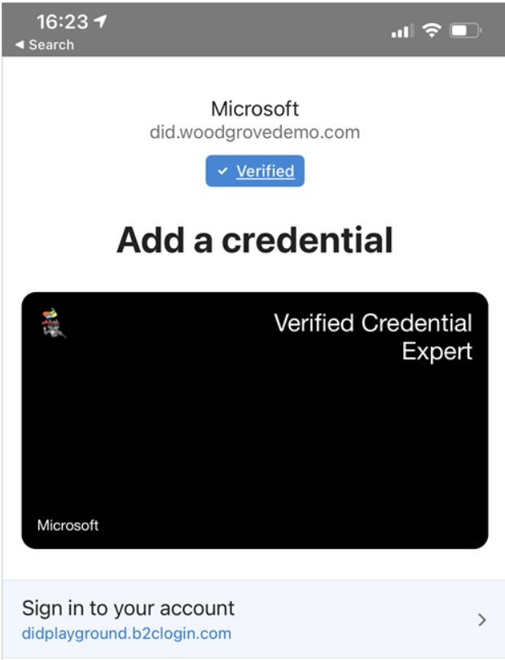
Sign in

Slide 27
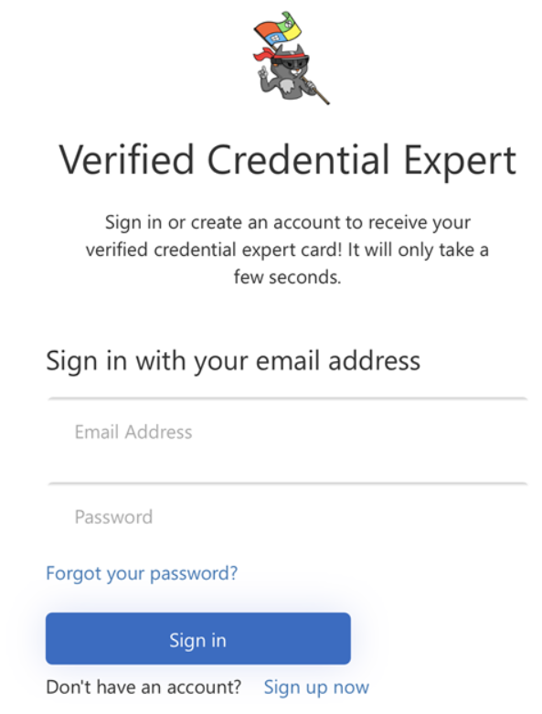
Sign in

Slide 28
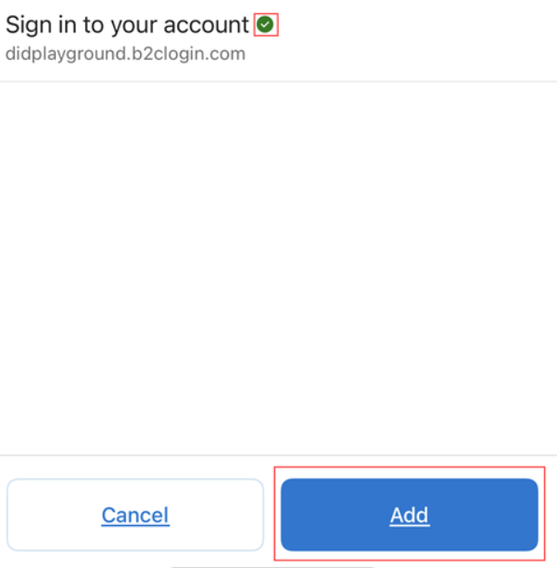
Add a VC

Slide 29
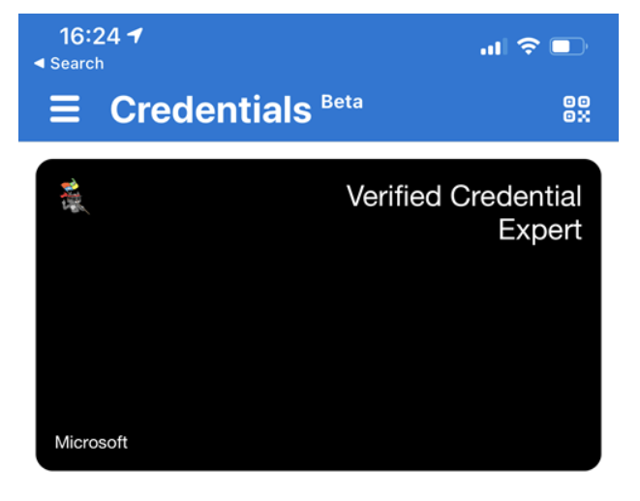
You now have a VC

Slide 30
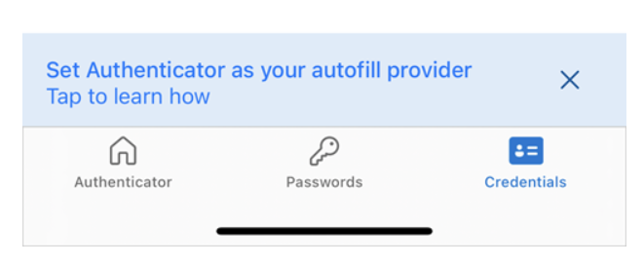
Issue a VC

Slide 31
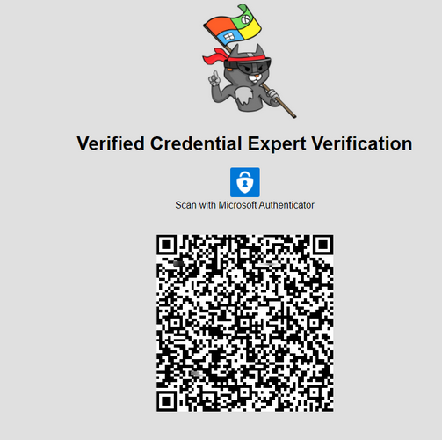
Verify a VC

Slide 32
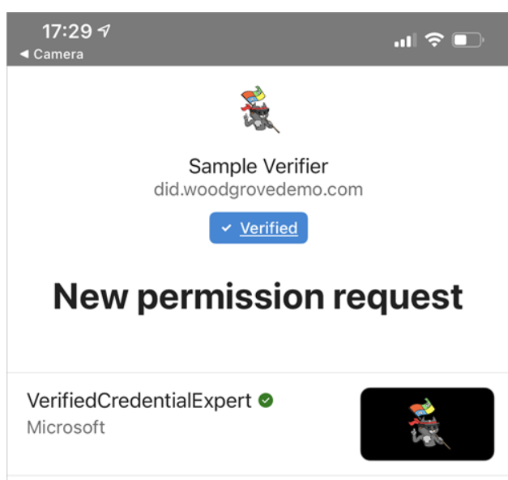

Allow

Slide 33
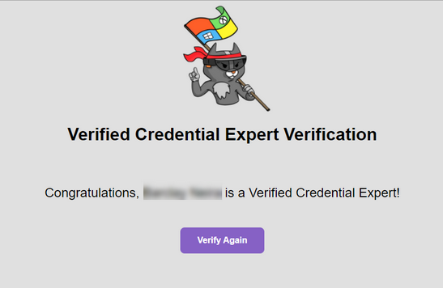
Verified

Slide 34
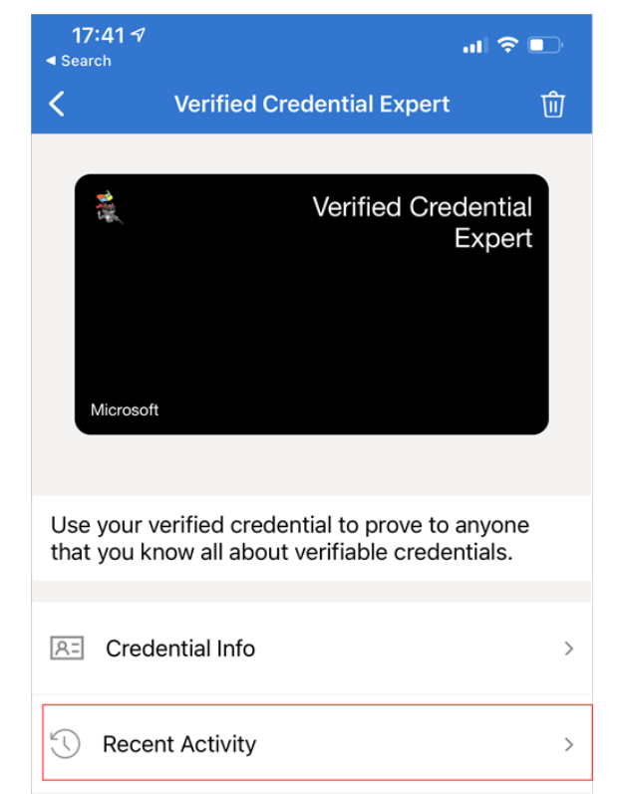
See your VC

Slide 35
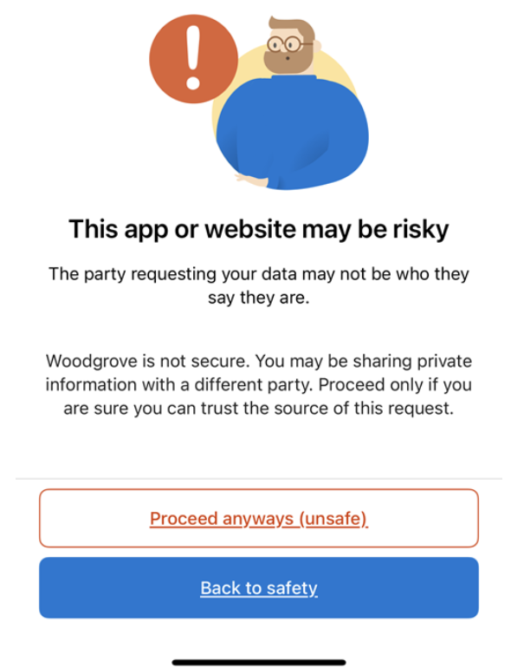
Domain not verified

Slide 36
After customisation

Slide 37
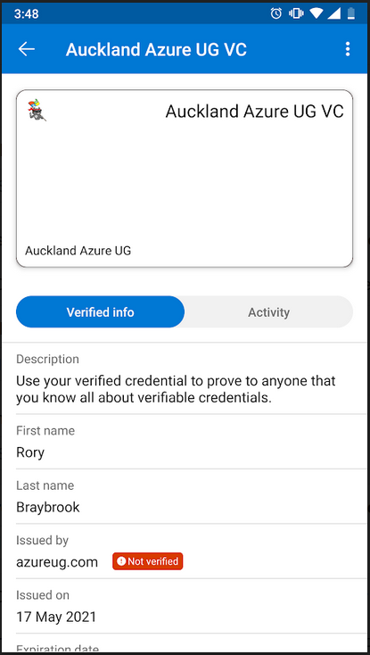

And then you see your Auckland Azure UG VC
Note:
For the next UG meeting, no Auckland Azure UG VC, no pizza ☺

Slide 38
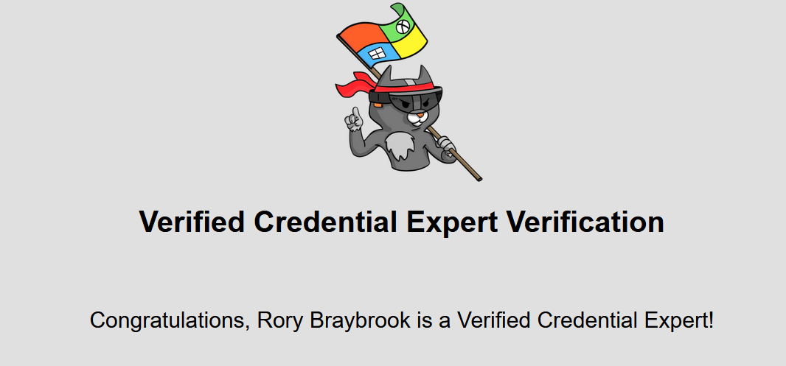
All good!

Slide 39
Video
https://www.youtube.com/watch?v=Ew-_F-OtDFI

Slide 40


Slide 41


Slide 42
References
https://www.youtube.com/watch?v=Ew-_F-OtDFI
https://www.microsoft.com/en-nz/security/business/identity-access-management/decentralized-identity-blockchain
https://www.xtseminars.co.uk/post/introduction-to-the-future-of-identity-dids-vcs
https://www.xtseminars.co.uk/post/issuing-dids-and-vcs-with-the-microsoft-example-app-and-authenticator
https://github.com/decentralized-identity/ion/blob/master/docs/Q-and-A.md
https://www.microsoft.com/en-nz/security/business/identity-access-management/decentralized-identity-blockchain
https://www.microsoft.com/en-nz/security/business/identity-access-management/verifiable-credentials
https://www.youtube.com/watch?v=r20hCF9NbTo

Slide 43
References
https://identity.foundation/ion/explorer/
https://docs.microsoft.com/en-NZ/azure/active-directory/verifiable-credentials/get-started-verifiable-credentials
https://docs.microsoft.com/en-NZ/azure/active-directory/verifiable-credentials/decentralized-identifier-overview

